Slide 1
Deep Learning 101: Apache MXNet
Simon Corston-Oliver, Amazon AI
17 July 2018
©2018 Amazon Web Services, Inc. or its affiliates, All rights reserved

Slide 2

Self-introduction: Simon Corston-Oliver
AWS AI, Deep Engine
Computational Linguist
Python aficionado

Slide 3

Apache MXNet
Apache (incubating) open source project
Framework for NNs
Created by academia (CMU and UW)
Adopted by AWS as DNN framework of choice, Nov 2016
Widely used within Amazon
http://mxnet.io

Slide 4
GPUs and CPUs
GPUs have thousands of cores
Can do matrix operations in parallel
Ideal for Deep Learning: 100X faster than CPU
NVIDIA GPUs with CUDA library commonly used
Apache MXNet helps us manage
Moving data to/from GPU(s)
Doing GPU calculations
CPU for data preprocessing, certain math functions
Common: Train on GPU, predict on CPU

Slide 5
Roadmap

Slide 6
Apache MXNet - Highlights
Ease of Use
Flexible APIs
Performance
Optimized for CPU, GPU, ARM (and more)
Bindings: Python, Scala, C, C++, R, Clojure
Examples and tutorials
Portability
Train on cloud, predict on edge
Highly scalable distributed training
ONNX support
Quantization, Sparse, NCCL, and more…
Model serving framework

Slide 7



Why do machine learning?
How many cats?
Complex tasks where you can’t code up explicit solutions
Notes:
ML was created to identify images of cats.

Slide 8
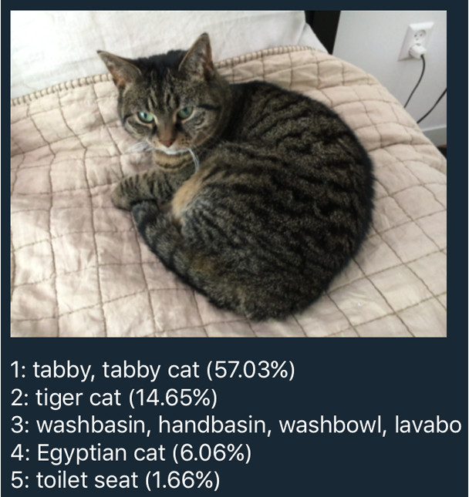
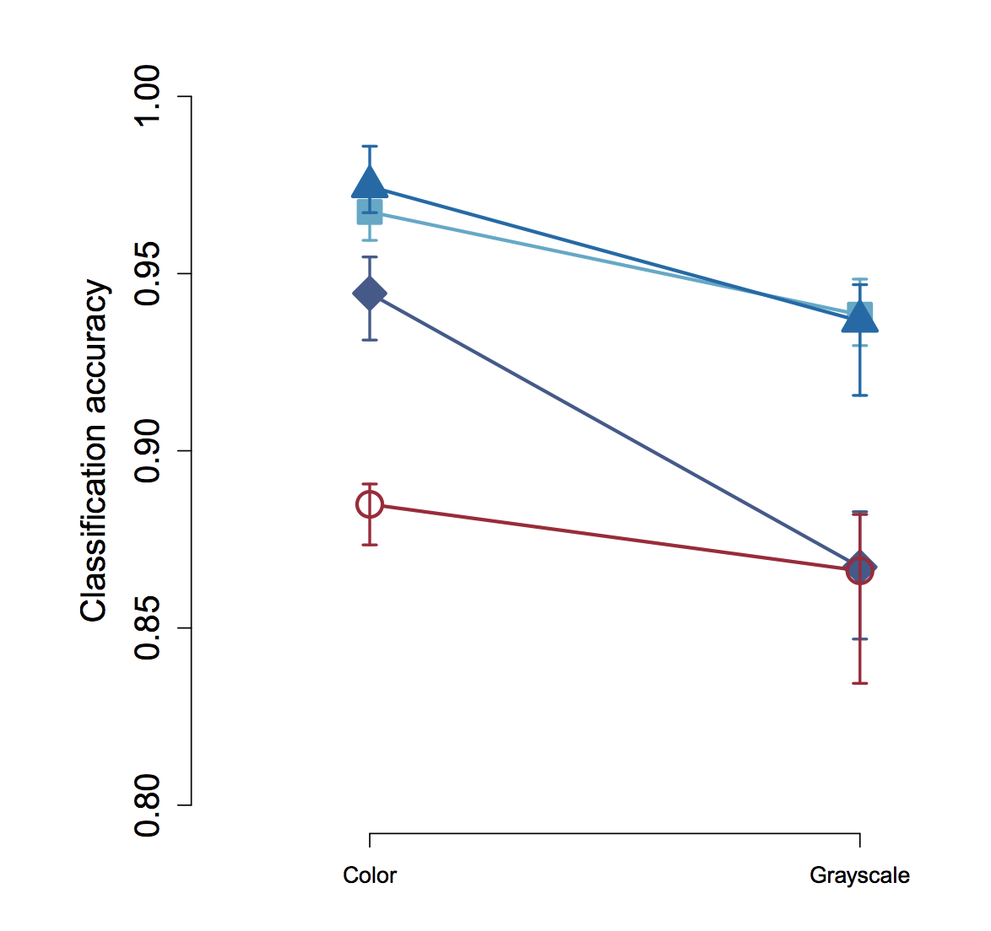
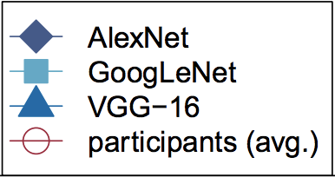
Deep Learning
Human-level (or better) performance

Slide 9
When not to use machine learning?
USA Social Security numbers
Stripping suffixes off English words
Exact numerical solution required
Notes:
Audience: better solution for each?
You could do these with NN e.g. learn an approximation for a numerical solution. But might not be the best solution.

Slide 10
Situating Deep Learning
Can machines think?
Can machines do what we can? (Turing, 1950)
AI
Machine Learning
Deep Learning
Data
Machine Learning
Answers
Rules
Notes:
Sometimes here people say “ML and DL” as if they were two different things.

Slide 11
Basic Terminology
Predict if a person earns >$50K
Age | Education | Years of education | Marital status | Occupation | Sex | Label
39 | Bachelors | 16 | Single | Adm-clerical | Male | -1
31 | Masters | 18 | Married | Engineering | Female | +1
Training examples (rows)
Input features / x
Label / ground truth / y
Notes:
Common ML educational task on old USA census data.

Slide 12
Basic Terminology
One-hot encoding to convert categorical features
Age | Education | Years of education | Marital status | Occupation | Sex | Label
39 | Bachelors | 16 | Single | Adm-clerical | Male | -1
31 | Masters | 18 | Married | Engineering | Female | +1
Age | Edu_Bachelors | Edu_Masters | Years of education | Marital_Single | … | Label
39 | 1 | 0 | 16 | 1 | … | -1
31 | 0 | 1 | 18 | 0 | … | +1
Notes:
All elements of input feature vector must be numbers.
Assign to positions in the vector, not just arbitrary numbers
There are more complex ways of encoding categorical features e.g. embeddings

Slide 13
Types of Machine Learning
Supervised
Data & labels
Unsupervised
Data, no labels
Regression
Semi-supervised
Data, some labels
Active learning
Dimensionality reduction
Classification, Labeling
Clustering
Reinforcement learning
Notes:
Semi-supervised?? Well, things that don’t neatly fit into one of those buckets or the other.

Slide 14
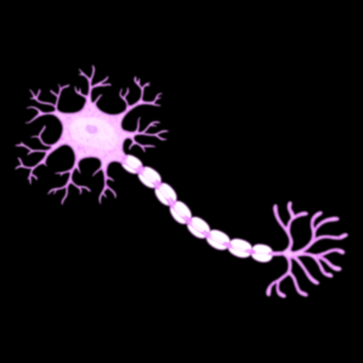

(Artificial) Neural Networks (ANN)
Inspired by the brain’s neurons
We have ~100B of them, and ~1Q Synapses
Inputs
Weights
Bias
Activation
b
x₁
w₁
$$y= φ(\sum_{j=1}^{n}{wjxj}+b)$$
Σ
φ
𝑦
x₂
w₂
…
x_{n}
w_{n}

Slide 15

Deep Neural Networks
Non-linear
Hierarchical feature learning
Scalable architecture
A Multilayer Perceptron (MLP)
Notes:
Hidden layers don’t all have to have the same number of neurons.
Output layer might be more than one.
This diagram shows a MLP for a task like classification, e.g. spam vs. non-spam

Slide 16
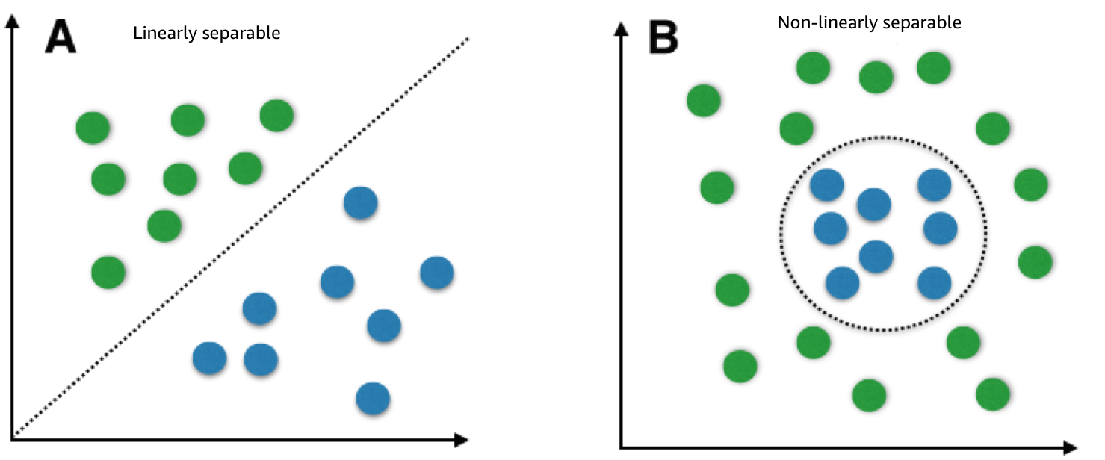
Linear and non-linear separability
Notes:
Good examples:
Imagine x = longitude, y = latitude
Linearly separable: blue dots = people in USA; green dots = Canada
Non-Linearly separable: blue = people in a city, green = people outside city

Slide 17
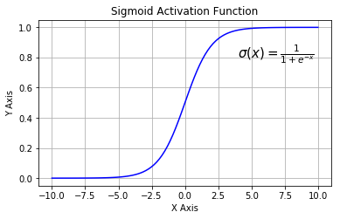
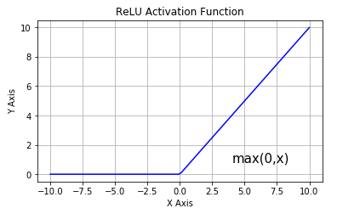

Activation Functions
$$y= φ(\sum_{j=1}^{n}{wjxj+ b)}$$
Determine how the neuron fires
Represent non-linearity
Notes:
Without these activation functions we would just have linear combinations of features and weights

Slide 18

Bias term
Each neuron has a bias associated with it
Moves the activation left or right on x-axis
$$y= φ(\sum_{j=1}^{n}{wjxj+ b)}$$

Slide 19
Parameters and Hyperparameters
Parameters
Numeric values in the model: weights and biases
Learned during training
Hyperparameters
Values set for the training session
Numeric e.g. mini-batch size
Non-numeric e.g. which algorithm to use for optimization
Hyperparameter optimization
Outer layer of learning / searching for hyperparameters

Slide 20
Training to estimate parameters
One parameter per connection
One bias per neuron
Find the values that minimize the loss on training data
Notes:
For trivial networks and small data sets you could possibly do this in closed form. But we need algorithms to train.

Slide 21
Accuracy vs. Loss
Accuracy: A percentage
Correct or not per example; Not differentiable
Loss: calculated during training
How far off is the current model?
Continuous value. Differentiable
Common loss functions
Mean squared error (regression)
Cross entropy: log of difference in probability
During training, minimize loss with an optimizer

Slide 22
Basic Optimizer: Stochastic Gradient Descent
Init params. Choose learning rate
Divide data: train, validate, test. Shuffle training
For each training example:
Feed forward, calculate output
Compare to truth, calculate loss
Calc. gradient for loss for each parameter
param = param – learning_rate *gradient
Notes:
For trivial networks and small data sets you could possibly do this in closed form. But we need algorithms to train.
Originally defined per example. Deep Learning usually calculates per mini-batch.
Feed forward using current values of weights and biases.
Only need to shuffle the training data
Note that we move in the opposite direction of the gradient i.e. go left if it’s positive, go right if negative.

Slide 23

Stochastic Gradient Descent
Take a series of steps
Specify a learning rate
Notes:
First, imagine that you have two parameters

Slide 24
Show me some code!
Notes:
MLP Jupyter not

Slide 25
http://mxnet.io
http://discuss.mxnet.io
/apachemxnet
@ApacheMXNet
@ApacheMXNet
/r/mxnet
Notes:
Add reddit image

